Slide 1
Key Skills for a Data Engineer

Slide 2
About me
Shawn - https://www.linkedin.com/in/shawn-xiao-43498636/
I’m a Sr. Data Engineer with over 15 years’ working experience in this area.

Slide 3
Overview of key terms
RDMS: Redshift,Oracle,SQL Server,Snowflake,MySQL,PostgreSQL
NoSQL: Cassandra,MongoDB
Programming: Python,Java,Scala,R,C++
Engine & WorkFlow: Spark, Airflow
Repo: Git
Cloud: AWS, Azure & GCP
Hadoop,Hive,Hbase,Linux,
Streaming: Kafka, Kinesis, Stream Analytics
Reporting: Tableau, PowerBI

Slide 4
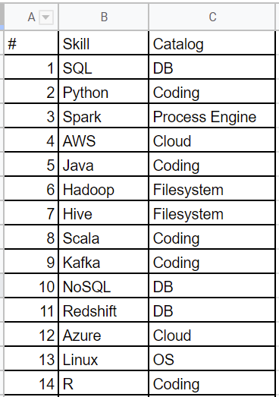
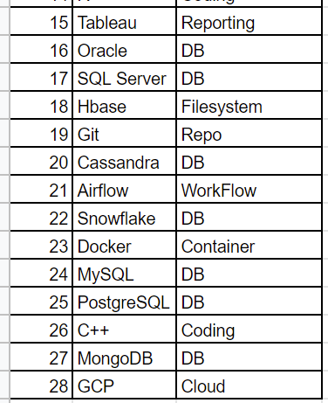
Skill ordered

Slide 5
Thanks for watching!
Please leave a comment if you have any questions!
If you like this video, please hit the below LIKE button and Subscribe it..

